Slide 1
Spell Check and auto suggest using trie
CS 512
Instructor: James Abello < abello@dimacs.rutgers.edu >
TAs: Harsha Srimath Tirumala
Authors – Raj Sundhar Ravichandran, Yuyang Liu, Jiyu Zhang

Slide 2
Project Description
Application has wide usage, to communicate textually or verbally more effectively
Greater application in schools, colleges and offices for professional communication
A digital version of dictionary, where one can check spelling and get suggestions
It can be embedded in other external softwares like Text Editor Text reviewer

Slide 3
Data Collection
The application requires a list of words to build the trie, like every dictionary need words
We picked the list of words from https://raw.githubusercontent.com/dwyl/english-words/master/words.txt, but it would work on any word list
There are two kinds of users in general,
normal users with only the read access
Administrators with both read and write access
Scenario1: School Online Exam System. Students are the normal users, who can check the spelling of their words and the Teachers are the administrators, who have the authority to alter the dataset In the Trie
Scenario 2: Embedded in Office software, where user can check the spelling when typing. And the administrator is the software engineers who can change the dataset

Slide 4
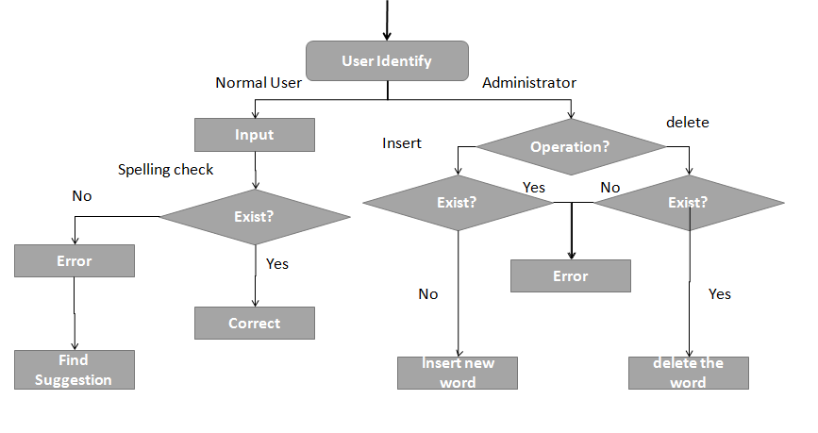
Conceptual Diagram

Slide 5
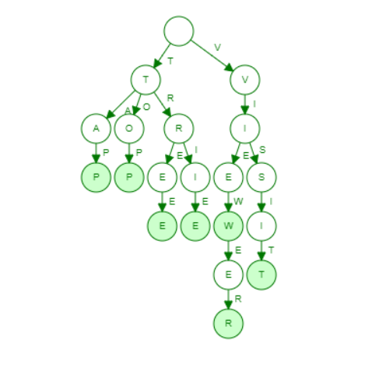
Implementation
Tries can be implemented either as layers of arrays or maps. We used arrays as it is easy to visualize.
Each node in a layer points to some other node in the next layer
End of word is marked by a flag
Alphabets A to Z are marked in an array with indexes 0 to 25

Slide 6
Implementation
Add
Navigates the trie for each character in the word
If it doesn’t exist, create a new array and point to the corresponding index of the character in 0 to 25
Mark the last character of the word as EndOfWord
Delete
Navigates the trie for each character in the word
Once EndOfWord node is reached remove the flag and delete each node from end if it doesn’t have any other child

Slide 7
Implementation
Spell Check
Sentence is given as input and each word is iterated in the sentence
Search for each word in the trie
If there is no such word, use Edit Distance algorithm to give suggestions
Auto Suggest
Traverse the trie till the characters of the word (eg – “tri”)
Find the suggestions based on the EndOfWords node reachable from that node
Suggestions for “tri” would be “trie”, “tried”, “trim” etc.

Slide 8
Interface Integration
Two versions of the application
Web based application – Useful to host in a system or can be used accessed online
Java based application – Standalone Windows/Android/iOS application
We display appropriate messages to users like
You don't have access. Check with your administrator!!
Already Exists!!
“word" Successfully added!!
No Misspelled Words!!
Suggested words

Slide 9
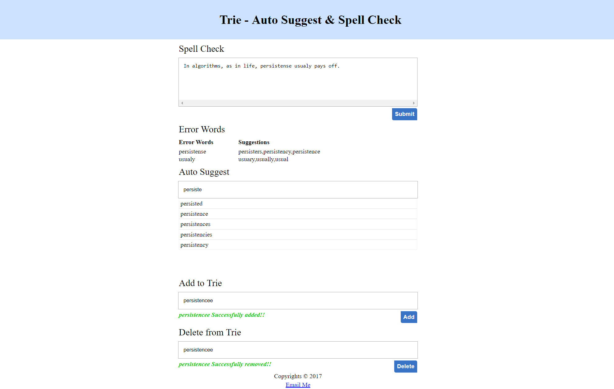
Sample View – Web Based Application

Slide 10
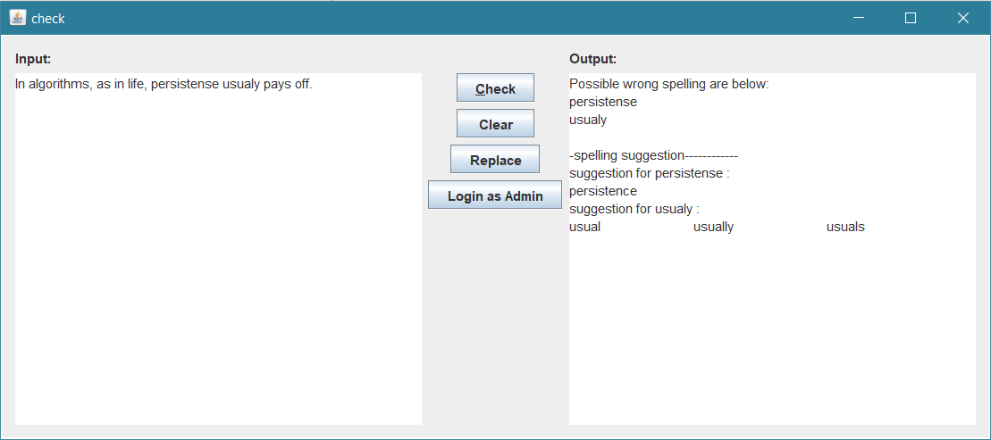
Sample View – Java Based Application

Slide 11
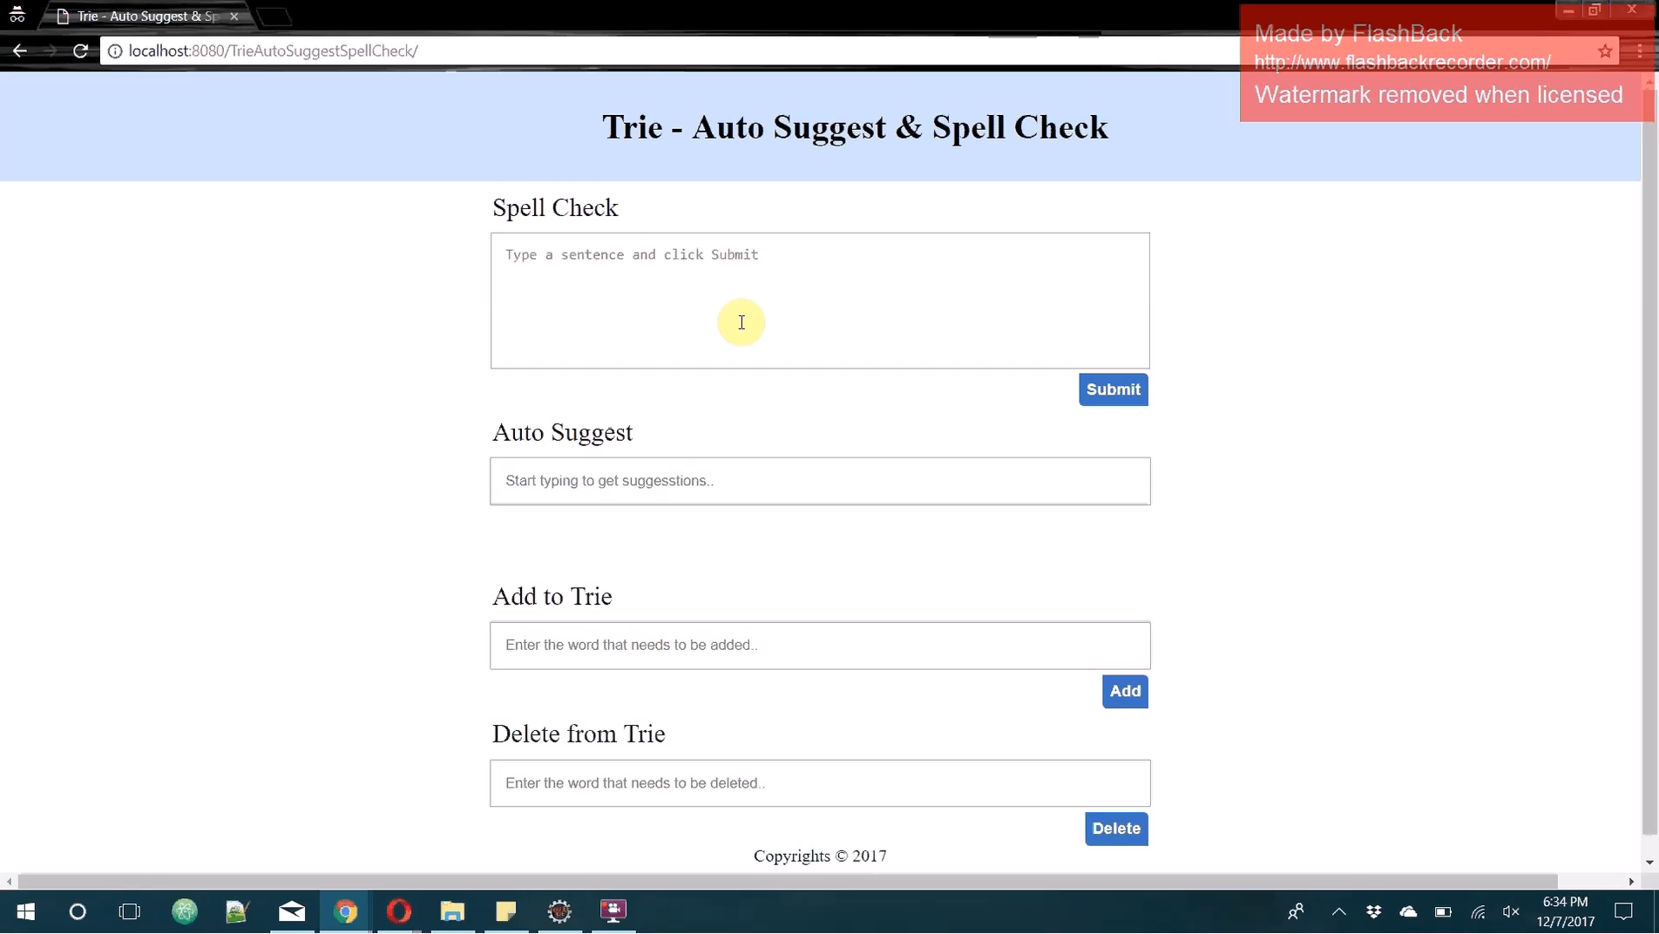
Video demo – Web based application

Slide 12
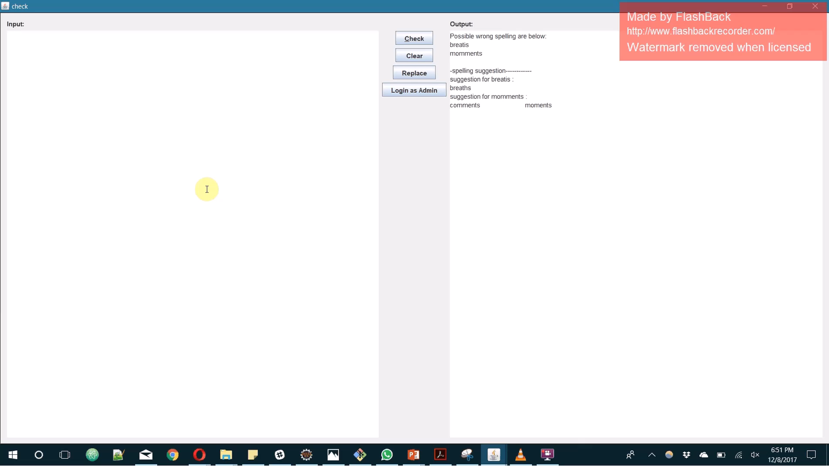
Video demo – Java based application

Slide 13
Future Work
The project could be expanded further by implementing:
Keep track of the search count for each word and bring the most searched words as suggestions
Directed Acyclic Word Graph(DAWG) – Uses fewer vertices to access words
Adding the following system mechanisms will improve efficient data access:
Maintaining the words in a database and accessing from it will be easier and cheaper for CRUD operations
The following data views will enhance our application usefulness:
Android/iOS based application for easy access
We would eventually like for our project to become an application where users can interact with the application for spell check and auto suggestions, in order to achieve better and effective communication

Slide 14
References:
https://en.wikipedia.org/wiki/Trie
Resources:
Java, JavaScript, HTML, jQuery

Slide 15
Acknowledgements
We got the list of words from the following website:
https://raw.githubusercontent.com/dwyl/english-words/master/words.txt

Slide 16
Any Questions ?

